Slide 1
Carbonia: Sea Level Alert!
Climate Change: Economy and the environment interactive

Slide 2
Before you start

Slide 3
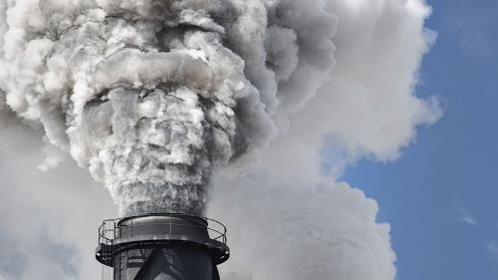
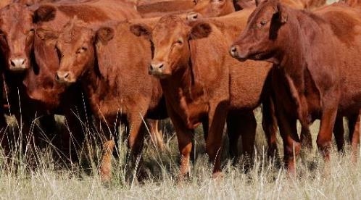
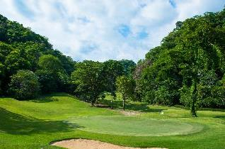
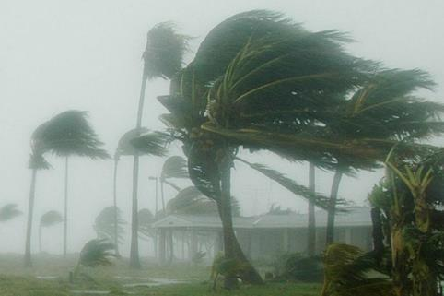
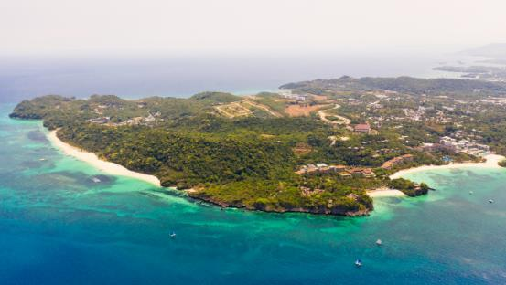
About the activity
This activity puts you in charge of a fictional island called Carbonia. You will be making a number of decisions about the country’s economy. In the activity your decisions will have direct consequences for Carbonia’s environment.
This activity has been designed in this way to help you think about human contributions to climate change. It is useful because you can observe in a short space of time, what will take decades to unfold in real life. To achieve this we have had to simplify some of the links between human actions and the impacts on climate change, and speed up the time it takes for those impacts to be felt.
While playing the game, bear in mind that in real life:
One country’s actions do not affect the global climate so dramatically
The effect of greenhouse gas emissions on rainfall reduction/sea level rise is not felt immediately. Climate change may occur gradually or nothing may happen for a while, followed by a dramatic change
Rising temperatures can increase rainfall in some circumstances, as well as reduce it.
Go back
Continue

Slide 4
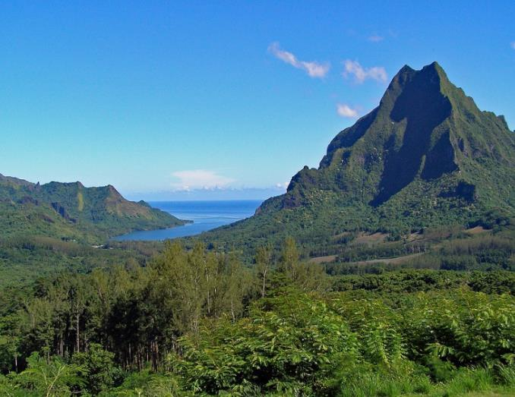
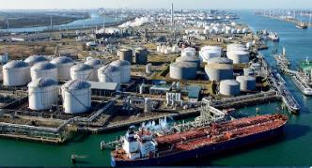
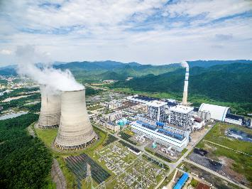
Introduction
Congratulations on becoming the Governor of Carbonia!
This is an exciting time as our economic prospects are starting to look good, with some big businesses talking about investing in our beautiful island.
As Governor it will be your job to make sure that we take best advantage of our economic opportunities. You must also ensure that Carbonia remains a pleasant place to live, not just for its human population, but for all the other animal and plant species that call Carbonia home.
Good luck!
Go back
Continue

Slide 5
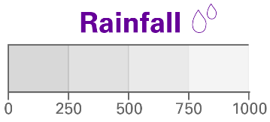
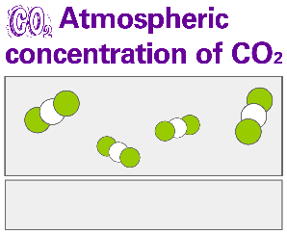
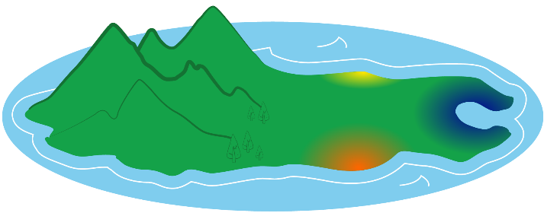
Briefing
Here’s a map of Carbonia and a dashboard with key information about the country.
Land area: 9,000 square kilometres (a bit smaller than Cyprus).
100 000
750mm
(42,000 households)
(about the same as an average year in the south of England)
380ppm
(parts per million)
As you can see, the port at Ocean City is ideally placed for importing raw materials. For many years we’ve imported oil for our plastics industry and coal for our coal-fired power station.
More recently it has been the place where huge wind-turbine blades have arrived on barges, as our scientists are investigating the use of wind power to produce electricity.
Several of the manufacturing companies based on the island are looking to expand. Unfortunately, they cannot find enough skilled people on Carbonia to fill their job vacancies.
If this continues they may be forced to shut down.
Go back
Continue
Power station
Industrial zone
Ocean City

Slide 6
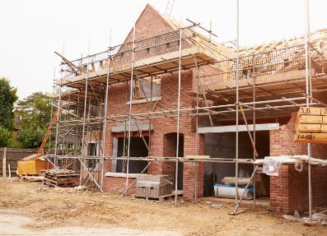
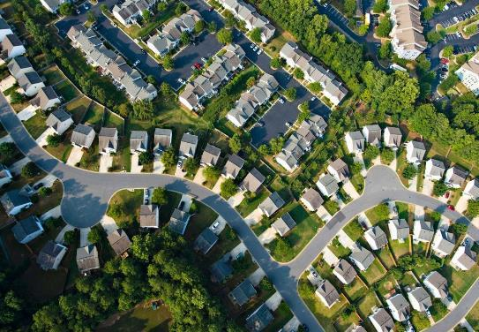
Question
One way to encourage more skilled workers to come to Carbonia would be to build more housing. Then the businesses could afford to stay open.
But you’re the Governor, so it’s up to you to make the decision:
Should we build more housing around Ocean City?
Go back
 SELECT YOUR ANSWER 

Slide 7
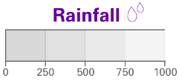
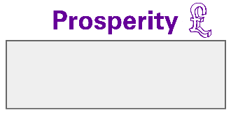
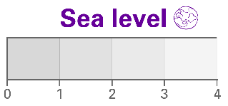
Dashboard
102500
750mm
2
0.3
o
381ppm
27 C
Continue
Power station
Industrial zone
Ocean City

Slide 8
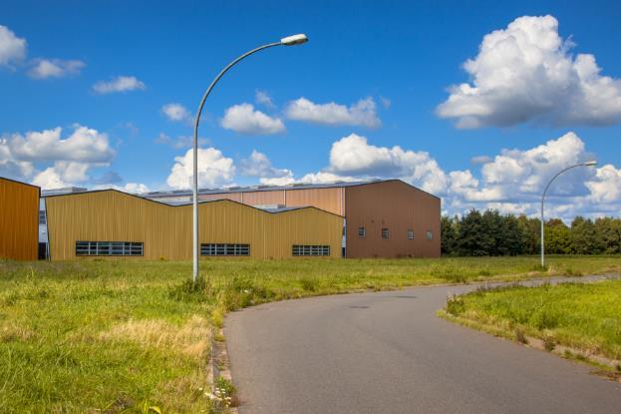
Question
Excellent news!
The new homes have all been filled and the companies are happy with the level of skilled workers available. In fact, they are so happy they are looking for permission to build more factories.
Should we expand the industrial zone around Ocean City by 10%?
 SELECT YOUR ANSWER 

Slide 9
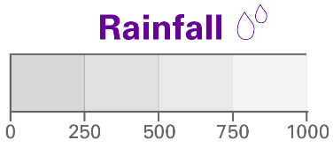
Dashboard
102 500
710mm
4
1
o
385ppm
28 C
Continue
Power station
Industrial zone
Ocean City

Slide 10
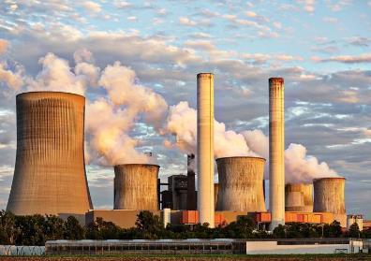
Question
Industrial output is up and the economy continues to grow. However, due to the increased need for electricity it might be a good idea to build another power station as our old one is reaching the limits of its capacity.
Also, scientists at Ocean City are saying that concentrations of atmospheric carbon dioxide have increased slightly and average temperatures are rising. This has led to a slight rise in sea level and a slight drop in rainfall. None of this is a problem at the moment but you should keep an eye on it.
Should we build a new coal-fired power station?
 SELECT YOUR ANSWER 

Slide 11
Dashboard
102 500
650mm
6
2
o
389ppm
£6
30 C
Continue
Power station
Industrial zone
Ocean City

Slide 12
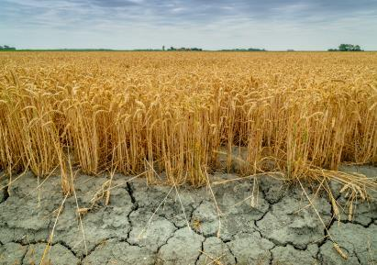
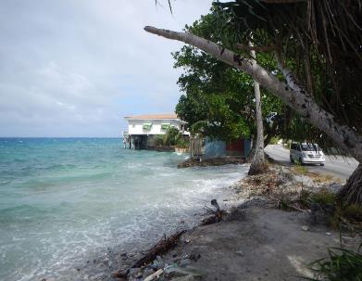
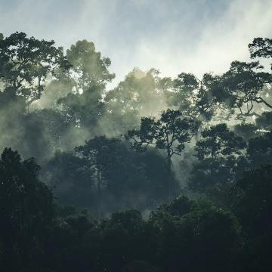
Question
With more electricity available from the power station, the economy is booming. However, new technologies, that would have reduced carbon emissions from the power station, were not included during the building process. This means that atmospheric carbon dioxide concentration is rising causing rising temperatures. Scientists at the University are again concerned about the effects of your economic policy on the environment.
The temperature rises are preventing cloud formation and rainfall. This is because the wet air that blows off the sea and usually cools as it rises over the mountains to give rain, is not able to cool enough. Crops are being lost and the farmers aren’t happy. We’re also in danger of losing our rare cloud forests which cover the landward sides of our mountains.
And there’s more – the rising temperatures are actually causing the water in the sea to expand. This might affect our ability to import raw materials and the whole economy could collapse!
Despite this, some of our large businesses are still looking to expand and skilled labour is becoming scarce again.
Should we build 4000 new homes around Ocean City?
 SELECT YOUR ANSWER 

Slide 13
Dashboard
102 500
650mm
6
2
o
389ppm
30 C
Continue
Power station
Industrial zone
Ocean City

Slide 14
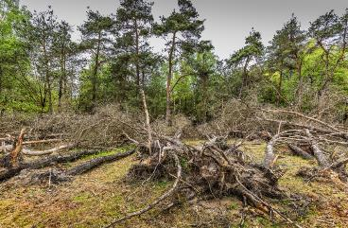
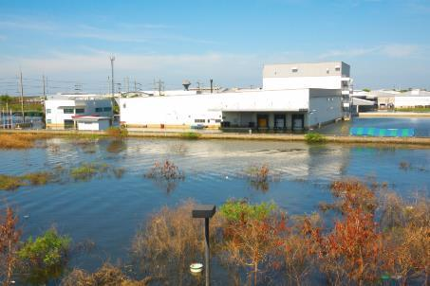
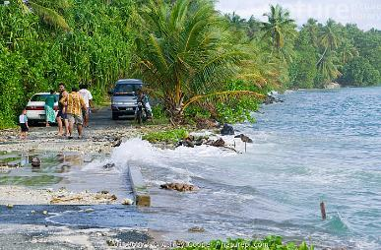
Feedback
Disaster!
Rising sea levels have flooded large areas of Ocean City. The port is completely unusable. Rainfall has decreased to the point where our scientists are saying that losing our cloud forests is now unavoidable. The crops have failed completely this year. We will have to import pretty much all of our food at huge expense.
The economic outlook is also bleak. With our port out of commission, we can’t provide our industry with raw materials. Businesses that haven’t already gone bust are likely to soon.
Would you like to try again?
 SELECT YOUR ANSWER 

Slide 15
Dashboard
99 000
750mm
-2
0.3
o
380ppm
27 C
Continue
Power station
Industrial zone
Ocean City

Slide 16
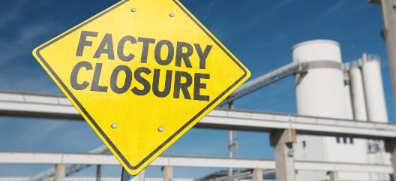
Question
Bad news!
Conglomerated Plastics Ltd. has laid off its workforce and closed its doors. They were one of our smaller companies and of course we all want to reduce our use of plastic, but other companies making more sustainable products, might do the same. You need to look at this situation again.
Should we build 1000 new homes around Ocean City?
 SELECT YOUR ANSWER 

Slide 17
Dashboard
95 000
750mm
-4
0.3
o
380ppm
27 C
Continue
Power station
Industrial zone
Ocean City

Slide 18
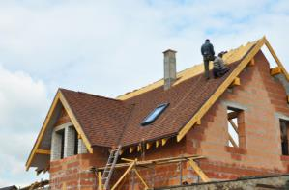
Question
Despite last minute negotiations, United Toys Inc. has stopped production and given notice to its workers. This is quite a blow because they were one of our mid-sized businesses.
You might still be able to turn this situation around by building new houses for skilled workers.
Should we build
1000 new homes
around Ocean City?
 SELECT YOUR ANSWER 

Slide 19
Dashboard
82 000
750mm
-8
0.3
o
380ppm
27 C
Continue
Power station
Industrial zone
Ocean City

Slide 20
Question
Things are getting out of control! Two of our largest companies couldn’t meet the demand from their main customers. They’ve lost their contracts and they’ve been forced to close.
Our bigger businesses are demanding an emergency meeting with you saying that they have lost confidence in your ability to manage the economy. This could be your last chance to try and turn things around.
Should we build
1000 new homes
around Ocean City?
 SELECT YOUR ANSWER 

Slide 21
Dashboard
65 000
750mm
-12
0.3
o
380ppm
27 C
Continue
Power station
Industrial zone
Ocean City

Slide 22
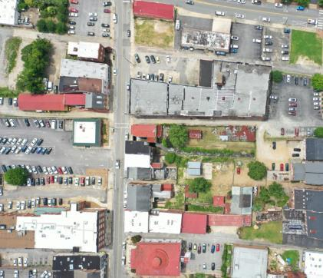
Feedback
We now only have a couple of smaller businesses left in the industrial zone and they probably won’t be here for much longer.
Sadly, your term as Governor has been a bit of a disaster!
Would you like to try again?
 SELECT YOUR ANSWER 

Slide 23
Dashboard
102 500
750mm
2
0.3
o
381ppm
27 C
Continue
Power station
Industrial zone
Ocean City

Slide 24
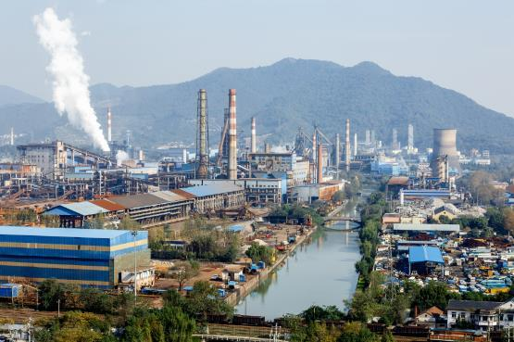
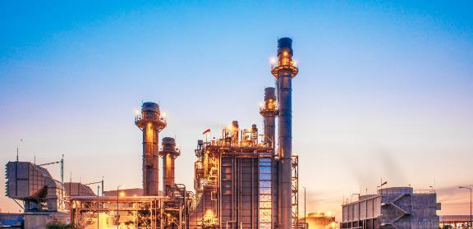
Question
Several of our manufacturing companies are grumbling, but so far they’ve managed to maintain their production levels. They’re looking at ways of increasing output though greater efficiency.
But this will only get them so far and they will still want extra space to expand.
Should we expand the industrial zone around Ocean City by 10%?
 SELECT YOUR ANSWER 

Slide 25
Dashboard
92 000
740mm
0
0.3
o
383ppm
27 C
Continue
Power station
Industrial zone
Ocean City

Slide 26
Question
Increased efficiency can only get you so far. Without room to expand two of our larger businesses have been forced to close. People are leaving Carbonia in search of work.
This is quite a blow to our economy and we could be in trouble.
Our remaining businesses are demanding a meeting with you as they have lost confidence in your ability to run the economy.
Should we expand the industrial zone around Ocean City by 10%?
 SELECT YOUR ANSWER 

Slide 27
Dashboard
80 000
740mm
-4
0.3
o
381ppm
27 C
Continue
Power station
Industrial zone
Ocean City

Slide 28
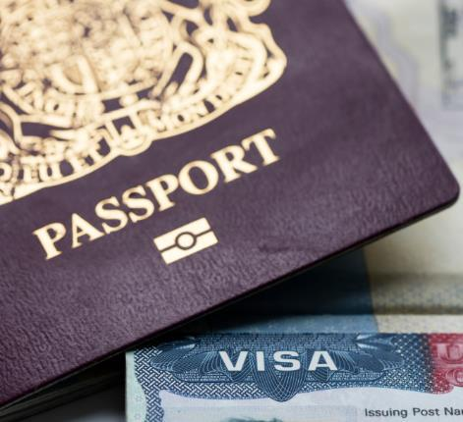
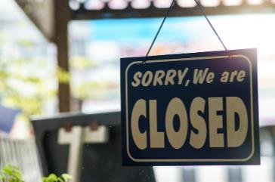
Feedback
Considering our economy was looking so promising you’ve made a bit of a mess of things. We only have a few businesses left and most of them are saying they’ll have to close down in the near future.
People are emigrating en masse. It doesn’t look as though you’ll be Governor for much longer.
Would you like to try again?
 SELECT YOUR ANSWER 

Slide 29
Dashboard
102 500
710mm
5
1
o
385ppm
28 C
Continue
Power station
Industrial zone
Ocean City

Slide 30
Question
There is some concern amongst businesses that the future lack of power could limit growth. However, the general population seems quite happy with your decision as there was concern about pollution and increased carbon emissions from a new power station. For now, businesses are investing in more energy efficient machinery and this has actually allowed some of them to expand.
Should we build a new coal-fired power station?
 SELECT YOUR ANSWER 

Slide 31
Dashboard
102 500
710mm
7
1
o
385ppm
28 C
Continue
Power station
Industrial zone
Ocean City

Slide 32
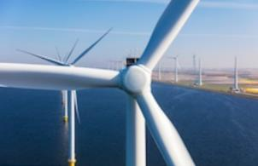
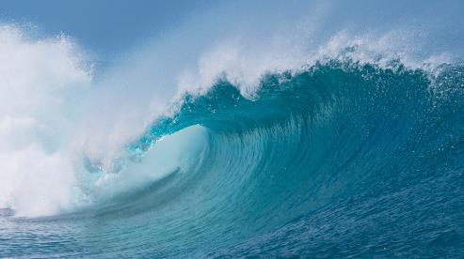
Feedback
Your decision to again refuse permission for the power station has been popular with the general public but businesses are not so happy. Some say they won’t last much longer.
However, scientists at Ocean City University are investigating the use of renewables such as wave and wind power, to increase our electricity generating capacity. This could solve all our problems- we could supply our businesses with the power they need and reduce carbon emissions.
The future looks good.
Would you like to try again?
 SELECT YOUR ANSWER 

Slide 33
Dashboard
102 500
660mm
4
2
o
388ppm
30 C
Continue
Power station
Industrial zone
Ocean City

Slide 34
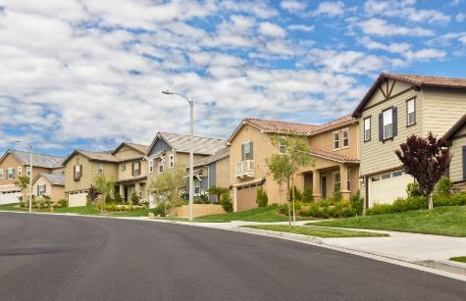
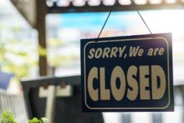
Feedback
The environmental situation may have stabilised for the moment but it is going to take a massive effort to turn things around completely.
Businesses are unable to find enough skilled labour as there is not enough housing on Carbonia to accommodate them. That means they can’t meet demand from their customers and they end up losing contracts. We need to be prepared for a bit of a downturn in the economy.
Would you like to try again?
 SELECT YOUR ANSWER 

Slide 35
Dashboard
101 500
750mm
1
0.3
o
381ppm
27 C
Continue
Power station
Industrial zone
Ocean City

Slide 36
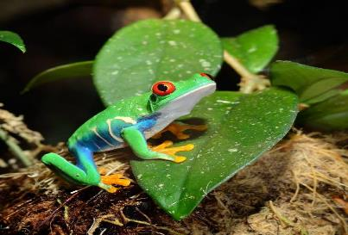
Question
Excellent news! The new homes have all been filled and the companies are happy with the level of skilled workers available.
In fact, they are so happy they are looking for permission to build more factories.
Should we expand the industrial zone around Ocean City by 10%?
 SELECT YOUR ANSWER 

Slide 37
Dashboard
102 500
710mm
4
1
o
385ppm
28 C
Continue
Power station
Industrial zone
Ocean City

Slide 38
Question
Industrial output is up and the economy continues to grow. However, due to the increased need for electricity it might be a good idea to build another power station as our old one is reaching the limits of its capacity.
Also, scientists at Ocean City University are saying that concentrations of atmospheric carbon dioxide have increased slightly and average temperatures are rising. This has led to a slight rise in sea level and slight drop in rainfall. None of this is a problem at the moment, but you should keep an eye on it.
Should we build a new coal-fired power station?
 SELECT YOUR ANSWER 

Slide 39
Dashboard
102 500
610mm
6
2
o
389ppm
30 C
Continue
Power station
Industrial zone
Ocean City

Slide 40
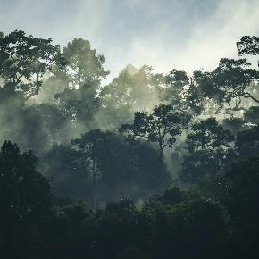
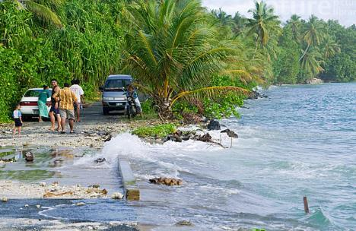
Feedback
The economy is booming! However, atmospheric carbon dioxide concentration is rising, causing rising temperatures. Scientists at the university are concerned about the effects of your economic policy on the environment.
The temperature rises are preventing cloud formation and rainfall. This is because the wet air that blows off the sea and usually cools as it rises over the mountains to give rain, is not able to cool enough. Crops are being lost and the farmers aren’t happy. We are also in danger of losing our rare cloud forests which cover the landward sides of our mountains.
And there’s more – the rising temperatures are actually causing the water in the sea to expand. This is causing sea level rises which our flood defences can only just cope with. This might affect our ability to import raw materials and the whole economy could collapse!
Your policies have brought us to the brink of environmental disaster.
Would you like to try again?
 SELECT YOUR ANSWER 

Slide 41
Dashboard
98 000
630mm
-2
0.3
o
383ppm
28 C
Continue
Power station
Industrial zone
Ocean City

Slide 42
Question
At last! This might turn things around a bit. All the homes are occupied and our industrial output is beginning to increase.
The remaining factories are looking for permission to expand.
Should we expand the industrial zone around Ocean City by 10%?
 SELECT YOUR ANSWER 

Slide 43
Dashboard
98 000
710mm
0
0.3
o
383ppm
28 C
Continue
Power station
Industrial zone
Ocean City

Slide 44
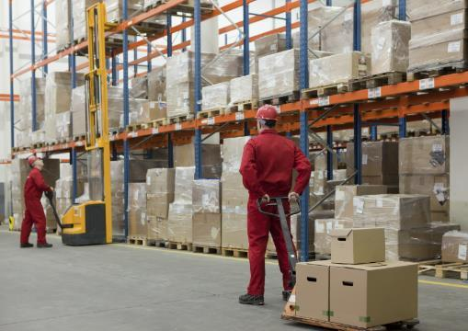
Feedback
Building new homes has led to a rise in our population and an increase in the amount of available skilled labour. The economy has seen a slight upturn but it definitely could be better.
Would you like to try again?
 SELECT YOUR ANSWER 

Slide 45
Dashboard
85 000
740mm
-7
0.3
o
381ppm
27 C
Continue
Power station
Industrial zone
Ocean City

Slide 46
Feedback
This may have come in too late. An increase in the amount of available skilled labour has encouraged a slight upturn in the economy but nothing fantastic.
Would you like to try again?
 SELECT YOUR ANSWER 

Slide 47
Dashboard
102 500
710mm
5
1
o
385ppm
28 C
Continue
Power station
Industrial zone
Ocean City

Slide 48
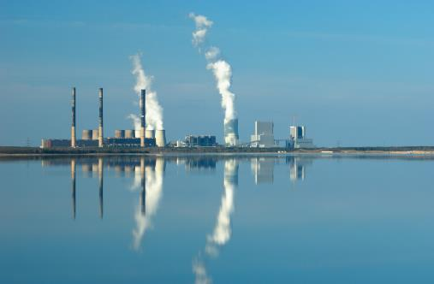
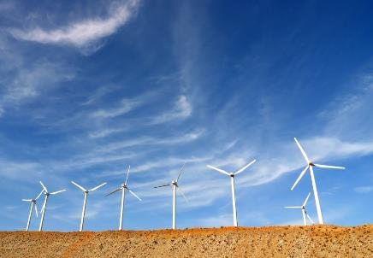
Feedback
There is some concern amongst businesses in the industrial zone that the future lack of power could limit growth. However, the general population seems quite happy with your decision as there was concern about pollution and increased carbon emissions from a new power station. For now, businesses are investing in more energy efficient machinery and this has actually allowed some of them to expand.
The future looks promising if we can solve the energy problem – we need more energy but fewer emissions.
Would you like to try again?
 SELECT YOUR ANSWER 

Slide 49
Dashboard
101 500
750mm
1
0.3
o
381ppm
27 C
Continue
Power station
Industrial zone
Ocean City

Slide 50
Question
Several of our manufacturing companies are grumbling, but so far they’ve managed to maintain their production levels. They’re looking at ways of increasing output through greater efficiency.
But this will only get them so far and they will still want extra space to expand.
Should we expand the industrial zone around Ocean City by 10%?
 SELECT YOUR ANSWER 

Slide 51
Dashboard
101 500
710mm
3
0.3
o
383ppm
28 C
Continue
Power station
Industrial zone
Ocean City

Slide 52
Feedback
This may have all come too late.
Expansion of the industrial zone has encouraged an upturn in the economy but nothing fantastic.
You should note that expanding the industrial zone will probably require a greater electricity generating capacity, i.e. a new power station.
On a positive note, the environment is looking healthy so although our economy may not be as great as it could be, at least we still have a beautiful place to live.
Would you like to try again?
 SELECT YOUR ANSWER 

Slide 53
Dashboard
80 000
740mm
-4
0.3
o
381ppm
27 C
Continue
Power station
Industrial zone
Ocean City

Slide 54
Feedback
Increased efficiency can only get you so far. Without room to expand two of our larger businesses have been forced to close. People are leaving Carbonia in search of work.
This is quite a blow to our economy and we could be in trouble.
Our remaining businesses are demanding a meeting with you as they have lost their confidence in your ability to run the economy.
Not a particularly good term in office.
Would you like to try again?
 SELECT YOUR ANSWER 

Slide 55
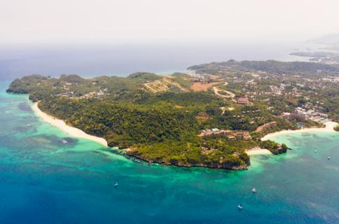
Debriefing
Debriefing
How did you do?
As you’ve discovered, being a decision maker isn’t easy. Whatever choices we make, we also have to consider how the measures we take affect the climate, the economy and society in general. There are lots of different factors involved in tackling climate change. Reducing fossil fuel use, introducing new technologies to reduce carbon emissions and moving to renewable energy, all have a part to play.
Continue

Slide 56
Go Further
Things To Do
Climate. Speaks
More Climate Change Interactives
For more activities, links to information about climate change, and ideas for discussions with friends and family.
With all of the new knowledge and skills you’ve developed, you’re ready to take part in Climate.Speaks.
You’ll explore information about climate change through the lens of different stakeholders and then you’ll prepare for a debate in these roles, to discuss how a more sustainable future could be achieved.
Now that you’ve completed the Economy and the environment interactive, make sure you complete the other climate change interactive too:
THINGS TO DO
All of the ‘things to do’ help build your essential skills. Go to skillsbuilder.org and find out more about the eight essential skills you need to succeed. Look at the skills framework and assess your own skills.
Go back
Continue
Deforestation interactive activity
Climate.Speaks activities

Slide 57
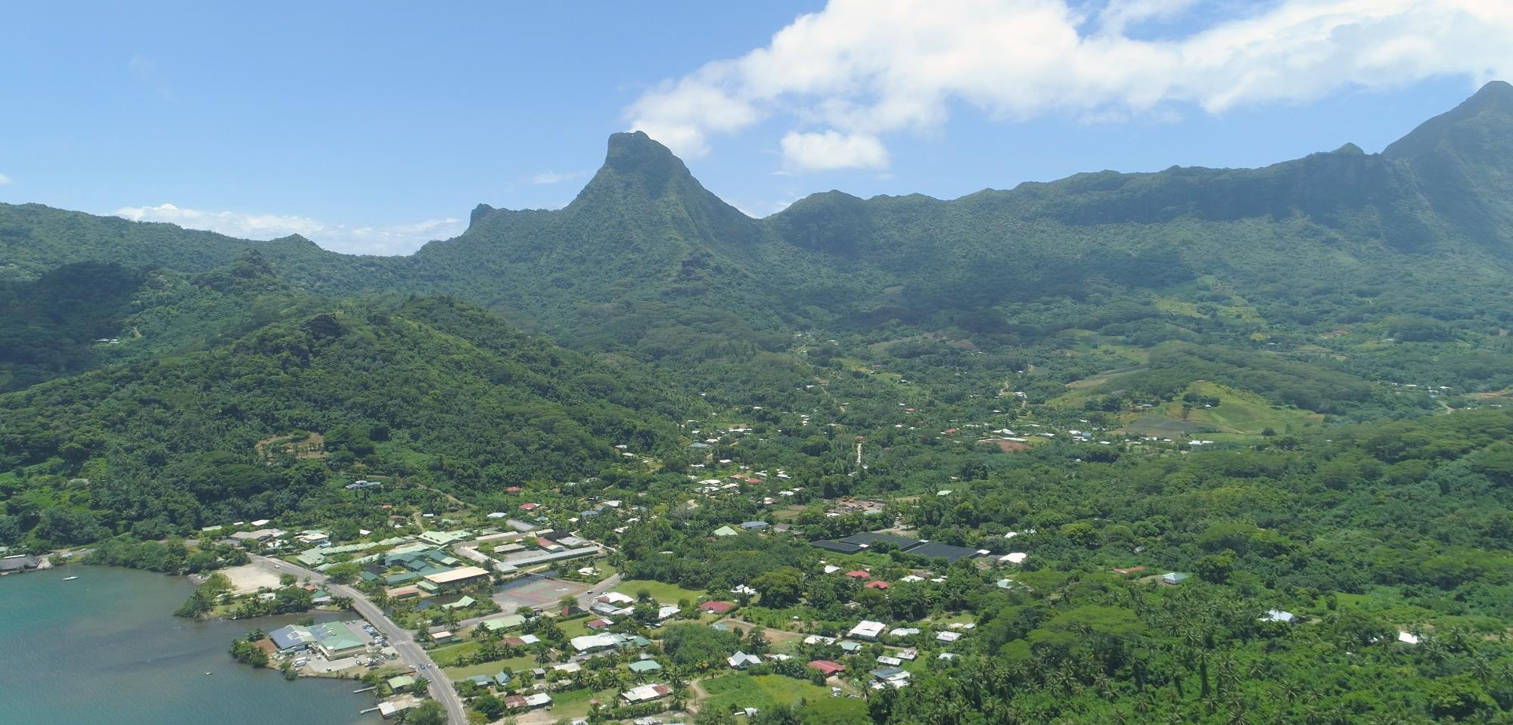
Things to do
Get talking
Create a manifesto
Imagine you are Governor of Carbonia. Your job is to write the country’s manifesto that contains pledges for how you will balance what’s good for the economy with what’s good for the environment This will ensure that Carbonia has a sustainable future. Your manifesto should include:
Issues to consider when building the economy, such as types of industry, energy production, carbon emissions, pollution, population and housing
Ways to protect the environment including technologies to reduce carbon emissions, and plastic, environment and biodiversity management
This quiz has helped you to understand that there are lots of different factors involved in tackling climate change.
Talk to your family and friends to find out if they are aware of how complex climate change really is. Discuss the following:
How can countries like Carbonia grow their economies while reducing carbon emissions?
Using the technologies we have today, how might it be possible for standards of living across the globe to increase while carbon emissions decrease?
Go back
Continue

Slide 58
Things to do
Take action
What can you do to take an active role in building a viable future for our planet? Will you join a campaign or protest to bring environmental change? Will you spread the word and share information with family and friends so they have a better understanding of the issues and can take action too? You decide.
World of work
Climate Scientists and Carbon Management Officers play key roles in monitoring and improving the environment, while Economists study trends and solve problems relating to the economy. What qualifications do you think you need for these roles? Go to startprofile.com to find out. Type the name of each career into the search.
Look under ’Qualifications and routes in’.
In the news
Keep up- to-date with the issues around climate change, how it’s affecting the lives of people around the world and what commitments governments and businesses have made to reduce carbon emissions and build a sustainable future. Listen to and read the news regularly and make sure you use reliable news sources.
Go back
Continue

Slide 59
Find out more
Rising sea level will undoubtedly have a massive impact on life on Earth. It will disrupt and possibly destroy entire eco-systems and it will result in the migration of millions of people, increasing pressure on water supplies and food production in the places where they settle.
The information in the Carbonia: Sea Level Alert! activity draws on information from a variety of sources (suitable for 16 + year-olds) including:
Want to find out more?
The Intergovernmental Panel on Climate Change (IPCC)
The umbrella organisation co-ordinates and publishes climate change research from around the world. You can read their most recent reports on deforestation on their website.
The Global Goals for Sustainable Development
Climate action and combatting rising sea-levels feature in Goal 13, one of the 17 Goals the United Nations has for creating a better world by 2030.
Go back
Continue
Our Planet Matters
Keep up-to-date with climate change and other Earth related issues with the BBC.
UK Environment agencies
These public bodies are responsible for protecting and improving the environment in the UK and for monitoring sea level changes:
Environment Agency (England and Wales)
Scottish Environment Protection Agency
Northern Ireland Environment Agency
Carbon capture and storage
Discover the science behind the technology that reduces carbon emissions in our atmosphere with these bp Educational service resources

Slide 60
bpes.bp.com
bpes.bp.com

